Slide 1

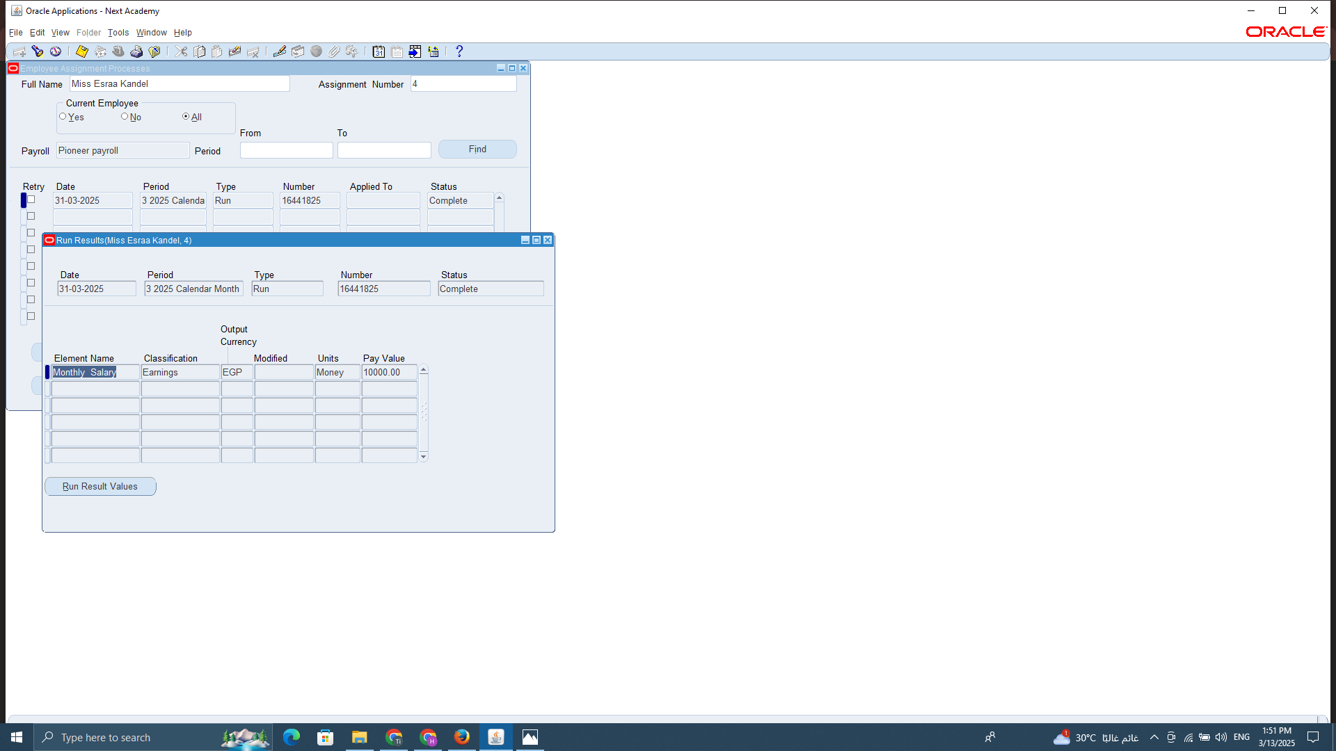
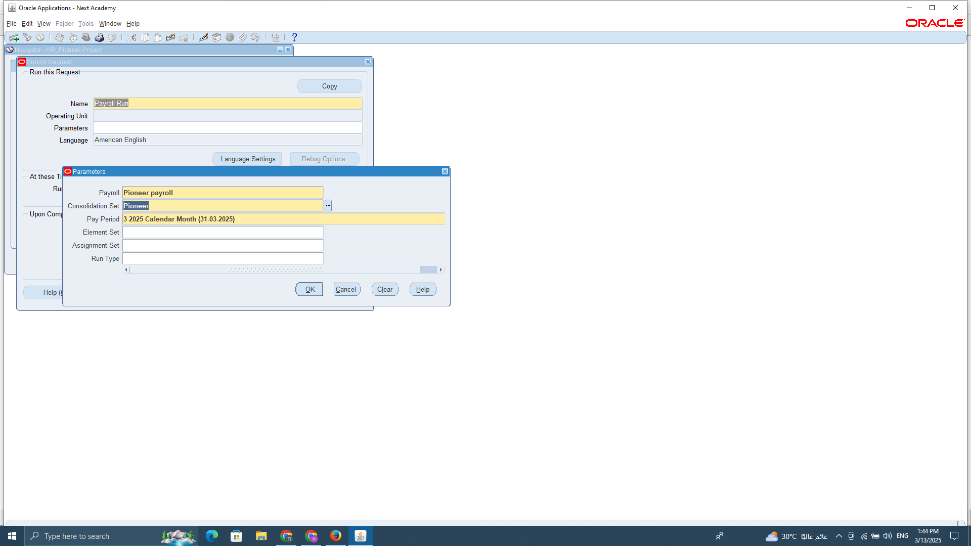

1. PAYROLL PROCESSED (PAYROLL RUN)
"A payroll run is the process of calculating employee salaries based on the requested period, taking into account any changes made to monthly elements for each employee."

Slide 2
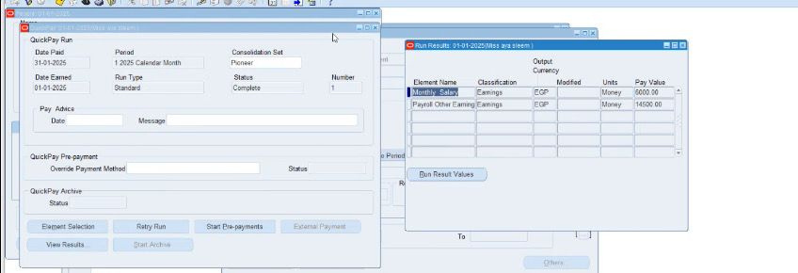
2. QUICK PAY RUNS
"Quick Pay is a functionality used for ad-hoc or off-cycle payroll runs, such as bonuses or corrections. It allows processing individual payments for employees as needed while ensuring accurate salary calculations, deductions, taxes, and benefits."

Slide 3

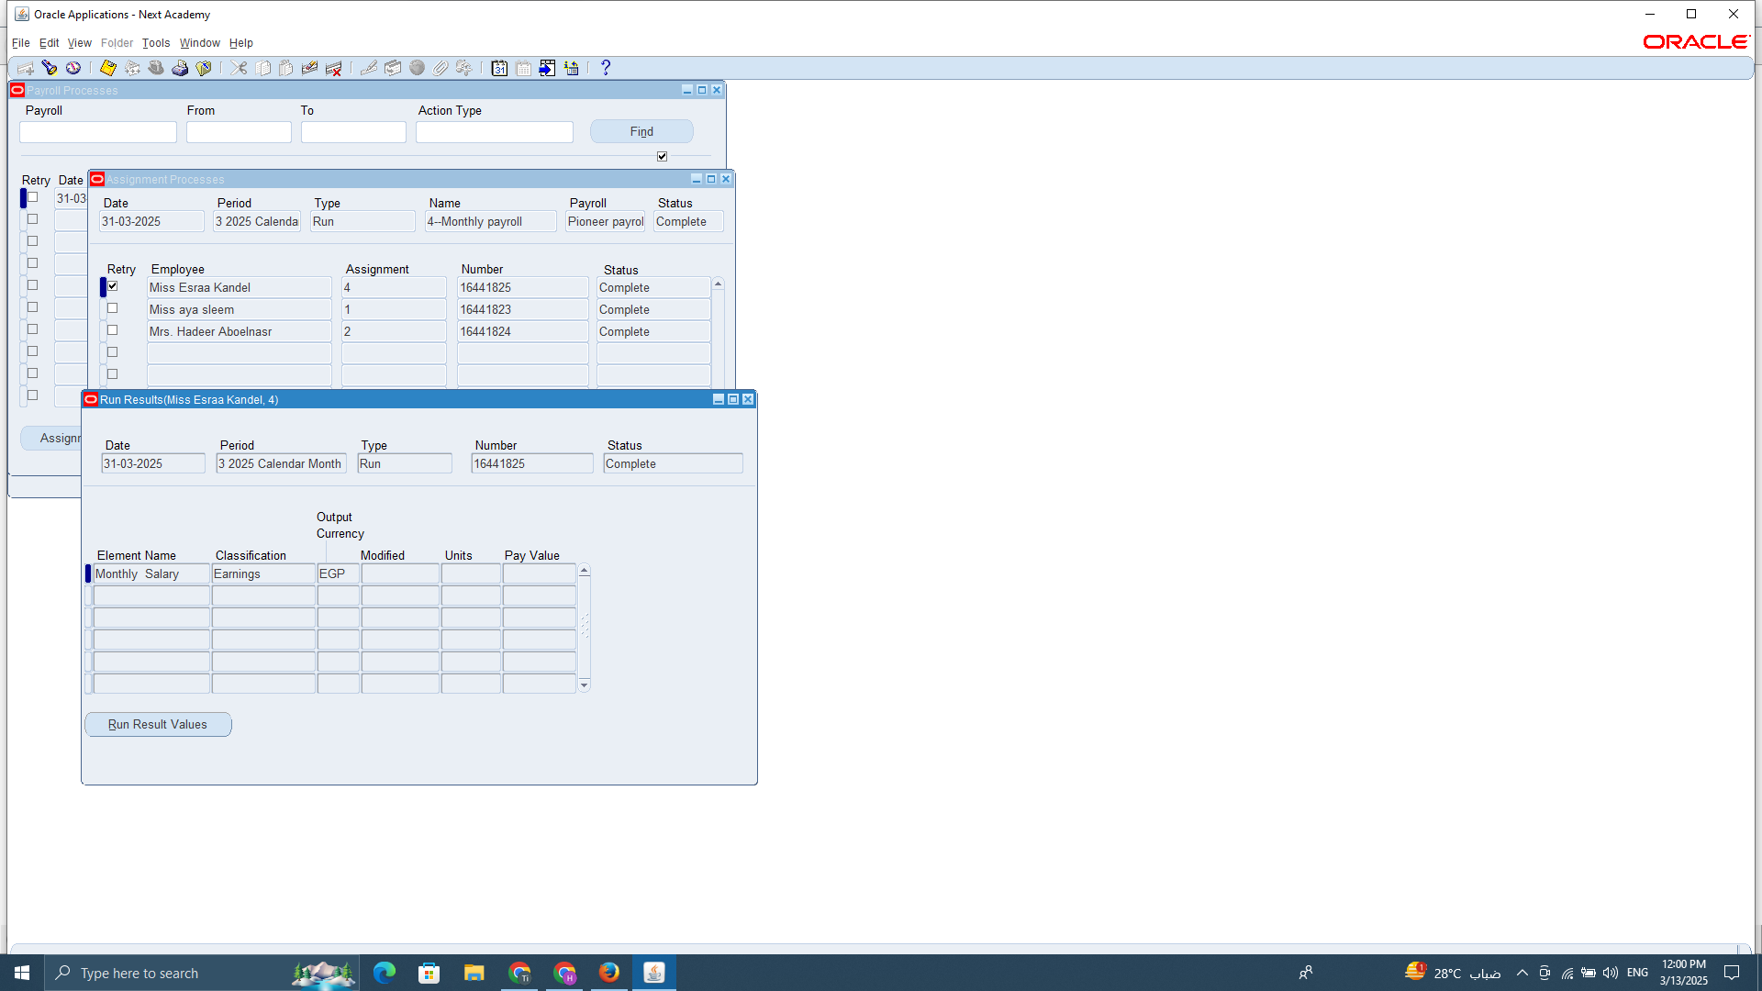
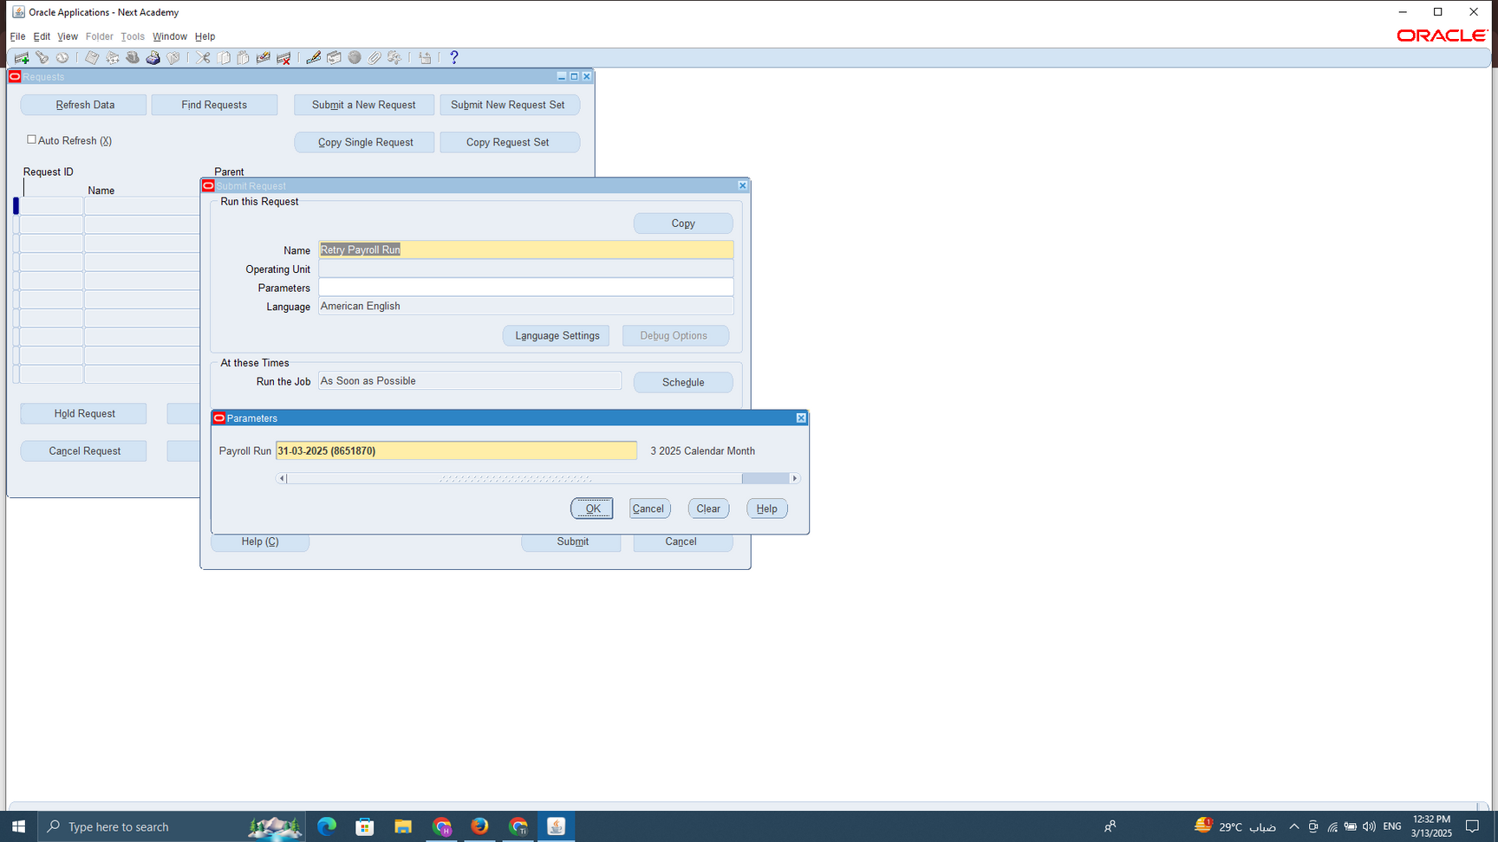
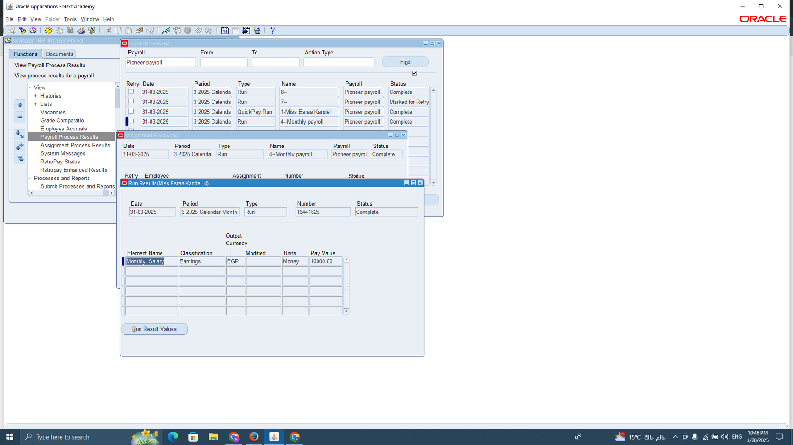
3. MANAGE ADJUSTMENTS AND
CORRECTIONS HANDLED
Retry
This option allows the system to reprocess payroll calculations without completely reversing the payroll run. It is typically used for minor corrections, such as adding a missing allowance or fixing a small deduction error.
2
1
3

Slide 4
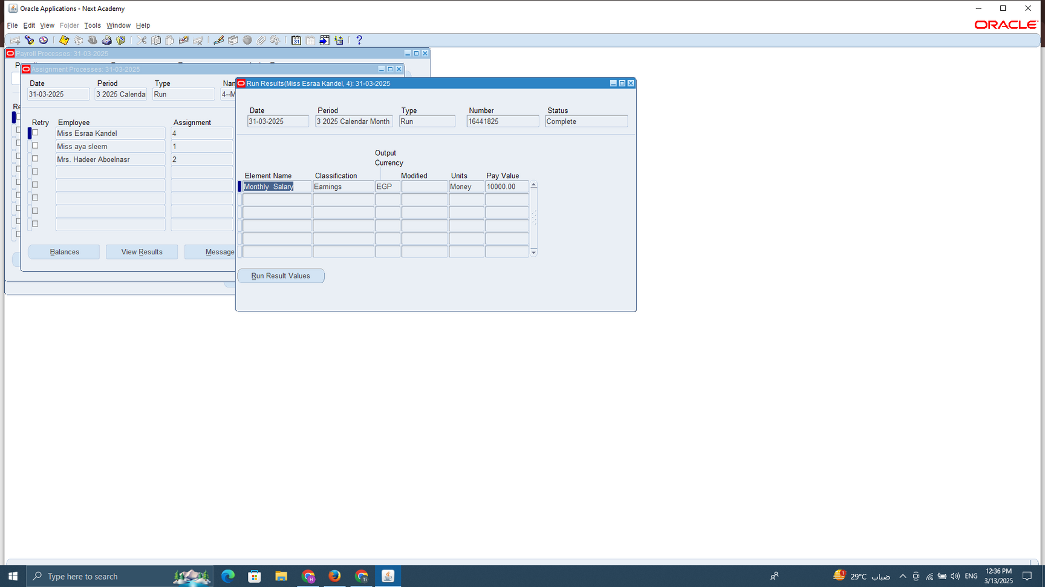
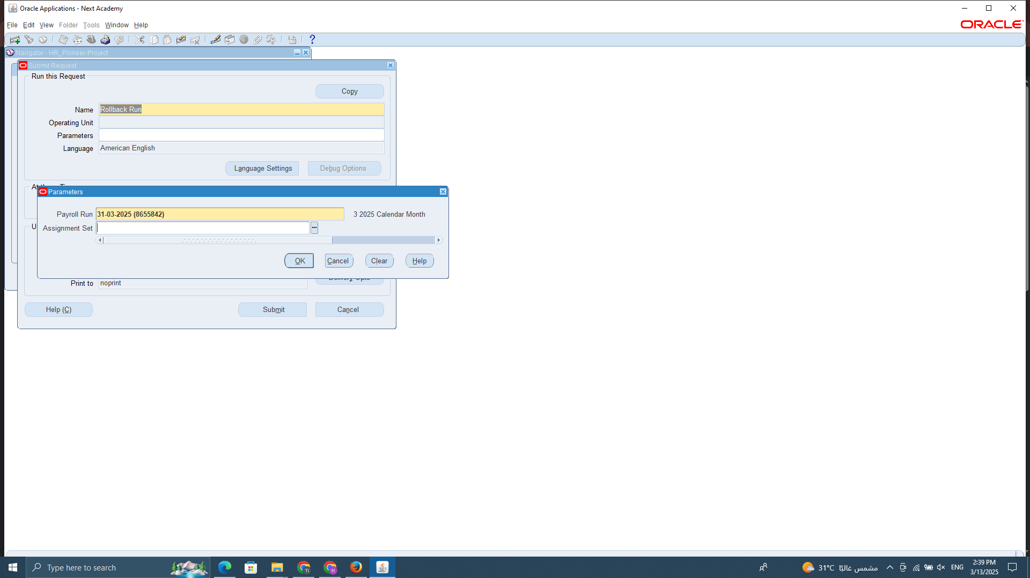
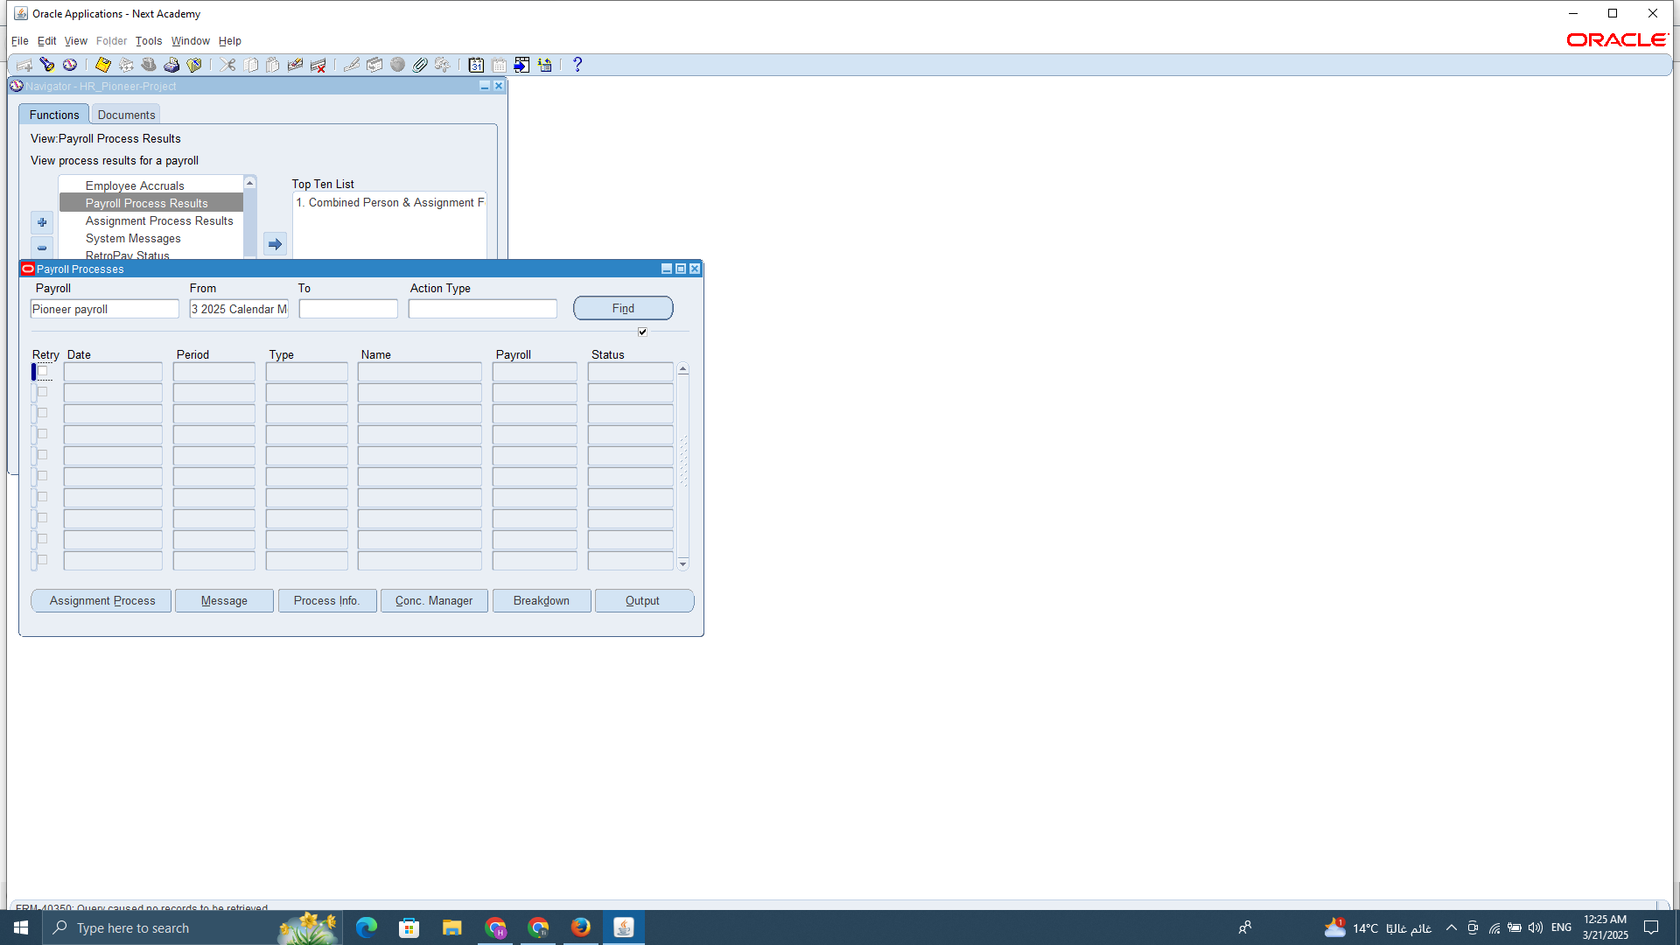
Rollback
This process reverses a payroll run, removing all calculations and returning the payroll data to its previous state before processing. It is used when critical errors are found, such as incorrect salary components or missing employee details.
2
1
3

Slide 5
4. BANK TRANSFER AND PAYMENTS
This step involves generating and approving bank payment files that contain salary details for employees. Once approved, these files are sent to the bank for processing, ensuring that salaries are transferred to employees' bank accounts on time.
Benefits:
Ensures timely salary payments to employees, improving satisfaction and trust.
Automates payment processing, reducing manual effort and errors.
Enhances financial security and compliance by maintaining accurate transaction records.
Facilitates easy reconciliation between payroll records and bank transactions.

Slide 6



PHASE THREE
PAYROLL RECONCILIATION AND REPORTING
All these reports should be created on oracle system through developer which will be responsible for linking all elements and data on monthly basis and any editing will be automatically customized on oracle system and check elements and employee criteria with our HR department for each function.
1. Payroll Reconciliation.
2. Payroll Reporting.
3. Close Payroll Period.
4. Audit & Compliance.

Slide 7


1. PAYROLL RECONCILIATION
2. PAYROLL REPORTING
Verifies payroll data for accuracy before processing payments.
Key Steps:
Verify Employee Earnings & Deductions &Net (salaries, overtime, bonuses, benefits) with finance costing entries which will be shared with finance department.
Verify monthly net salary from payroll data with bank reconciliation
Reconcile Bank Transactions with payroll data and finance costing entry.
Verify costing with bank reconciliation
(Sharing cost entries with finance to validate and virtify the bank transaction with costing entries)
Provides insights into payroll expenses, taxes, and compliance.
Key Steps:
Payroll summary: Total head count, total earnings, total deduction, current month.
Employee payslip report: is a detailed, personalized document generated for each employee, summarizing their earnings, deductions, and net salary for a specific pay period. In Oracle ERP, this report can be automated to notify employees via email or the self-service portal, ensuring transparency and compliance.
deduction report : Generate reports that show all deductions on payroll shared with finance department to represent every deduction need to be paid to service provider (mobile installation deduction, finance deduction)
Total liability report : Determine income tax deduction in payroll which give tax reconciliation (tax receipt) to tax porter.

Slide 8



4. AUDIT & COMPLIANCE
3. CLOSE PAYROLL PERIOD
Finalizing payroll records and ensuring proper closure.
Key Steps:
Lock Payroll Records (prevent unauthorized changes).
Review Final Payroll Reports (confirm data accuracy).
Submit Taxes & Deductions (pay liabilities and contributions)
Finalize payroll for the period and ensure all payroll transactions are posted to the General Ledger.
Regular audits ensure accuracy and maintain compliance.
Payroll Audit Checklist:
Review Tax Filings & Payments (timely and accurate submissions).
Ensure Labor Law Compliance (minimum salary, overtime, tax laws).
Maintain Payroll Documentation (records for audits & legal purposes)
Conduct an internal audit to ensure payroll compliance with company policies and local tax regulations.
Address any discrepancies found during the audit process and make sure to be covered of any upcoming audit for this.

Slide 9
Payroll Run
SUMMARY
Quick
Pay Runs
Define Payroll Elements
Set up Employee Payment Methods
PAYROLL CONFIGURATION AND EMPLOYEE SETUP
PAYROLL PROCESSING AND ADJUSTMENTS
Manage
Adjustments and
corrections
Payroll calendar
PAYROLL AND MANAGEMENT PROCESSINGIN ORACLE ERP
Bank
Transfer
and
Payments
Update Employee Records
PAYROLL RECONCILIATION AND REPORTING
Audit
& Compliance
Payroll Reconciliation
Payroll Reporting
Close Payroll Period

Slide 10



Pioneers
Thank you for your time and attention!
HAPPY TO ANSWER ANY QUESTIONS YOU MAY HAVE

